Slide 1
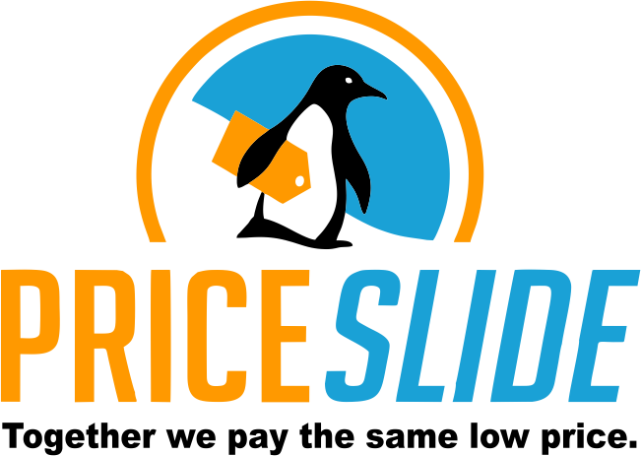

Slide 2
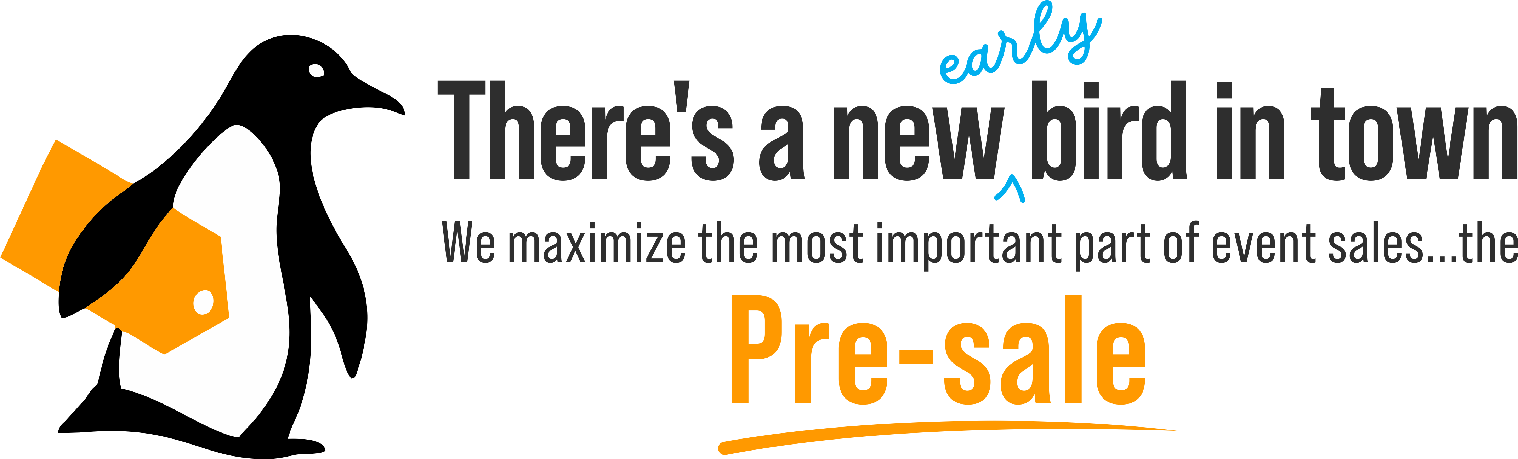


Slide 3

Your Pre-Sale on Steroids!
Problem
Solution
Attendees wait until the last second to purchase tickets
PriceSlide: Group buying meets dynamic pricing
FACT
Offering an early bird rate is currently the most effective tool in ticket sales (used by over 51% of all events*)
PriceSlide can increase Pre-Sale by over 4x !
* according to a study from Event MB

Slide 4
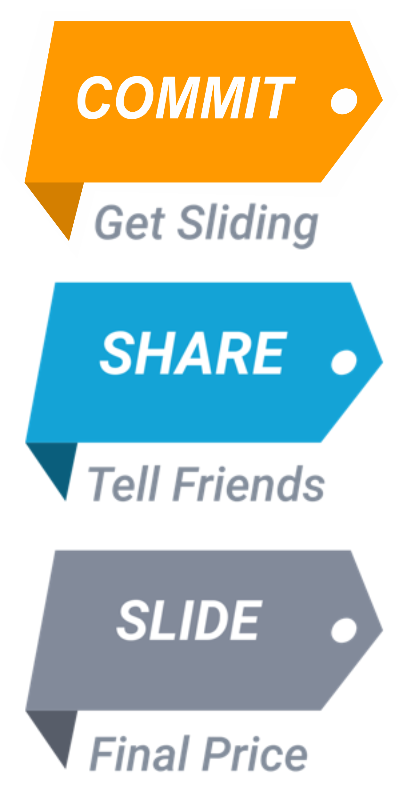
The Power of Group Dynamic Pricing
Jump on the slide! You aren’t paying for anything just yet, but you are committing to the current price.
Tell your friends! The more people who commit, the lower the price drops for EVERYONE.
Watch the price slide! As more people commit, the price continues to drop. Whatever the price is at the end of the promotion, that’s what EVERYONE pays!

Slide 5
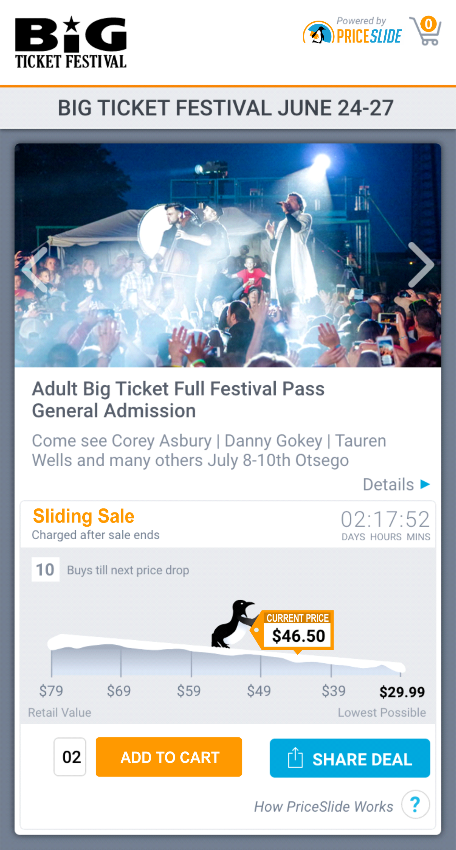
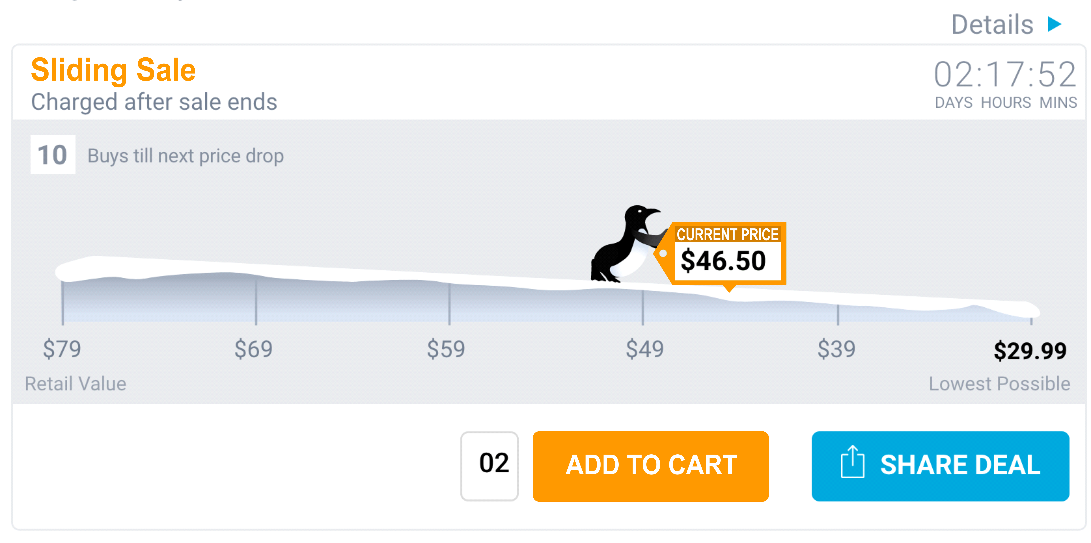
Start Sliding
What your customer sees

Slide 6

Power to the Organizer AND the Attendee
YOU map out the pricing structure so your price doesn’t go down until your volume goes up
*Natural incentive to share
*Establishes trust in audience
Recruits customers through those who have already committed
*Up to 400% increase in sales

Slide 7
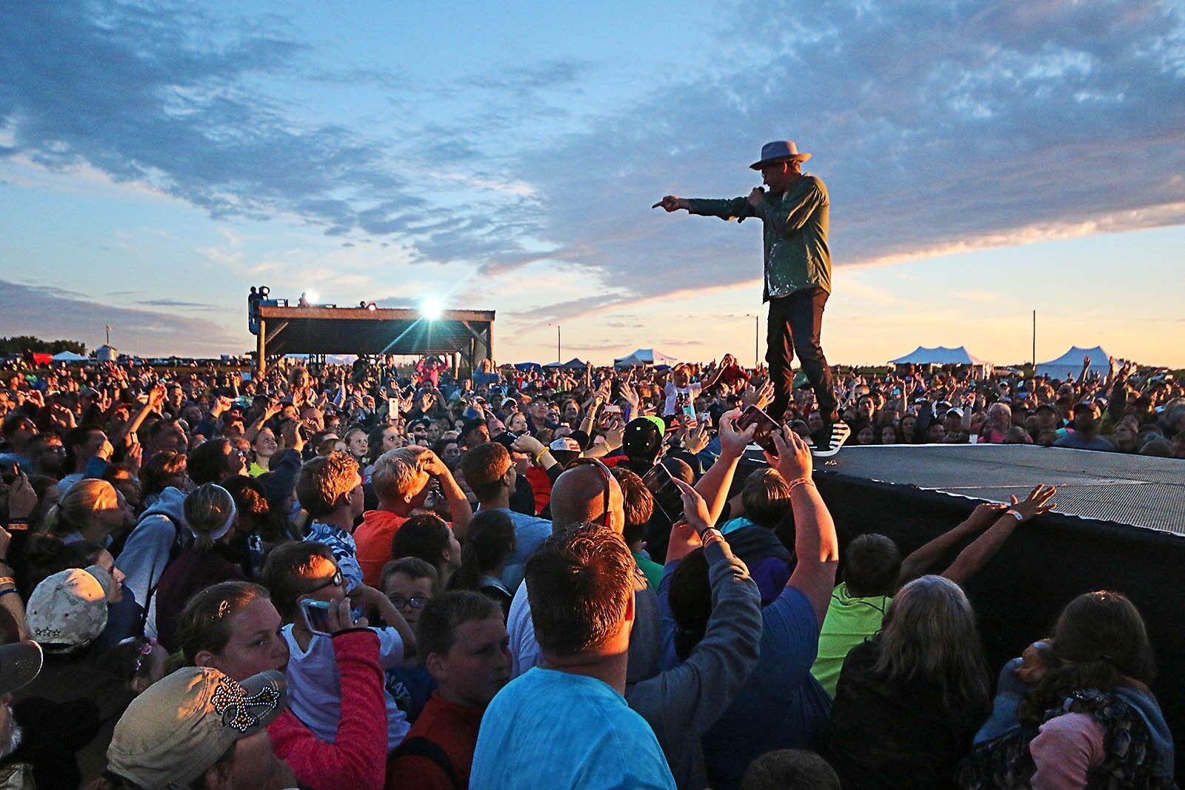

PriceSlide Case Studies
Ticket Sales for RiseFest in Sheldon, IA
Year one: Saw over 100% increase from previous years’ ticket launches
Year two: within 1% of matching previous year’s record sale plus increased base ticket price by 20%

Slide 8
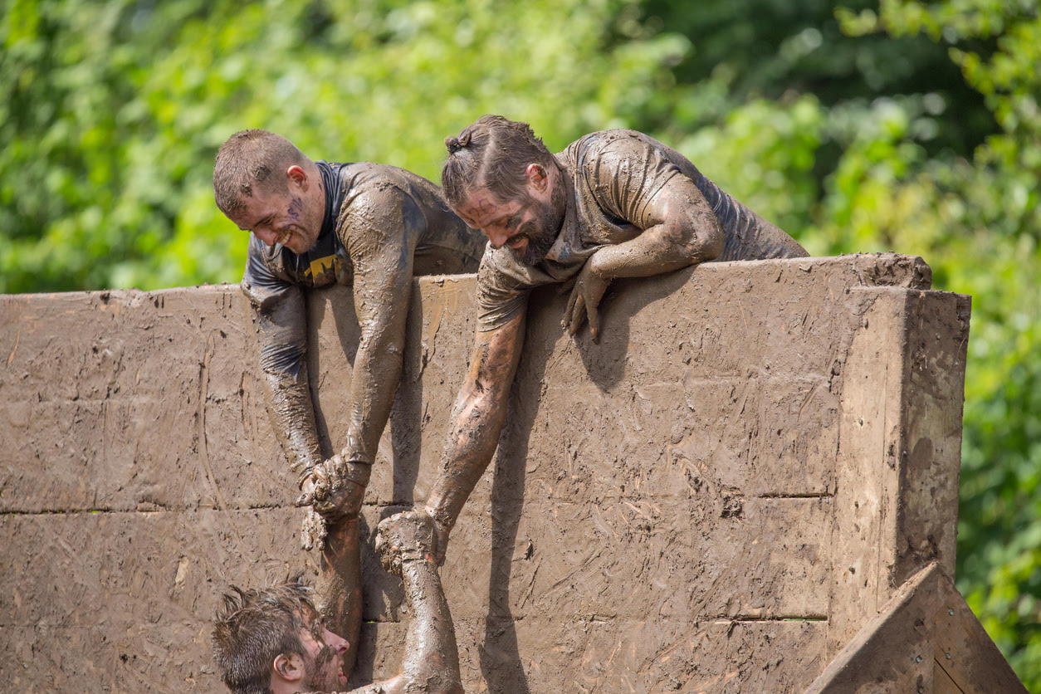

PriceSlide Case Studies
Race Registration for Mud Run in Grand Rapids, MI
Saw 200% increase in race registration launch
Registrations up 33% overall (previous 3 year average)

Slide 9
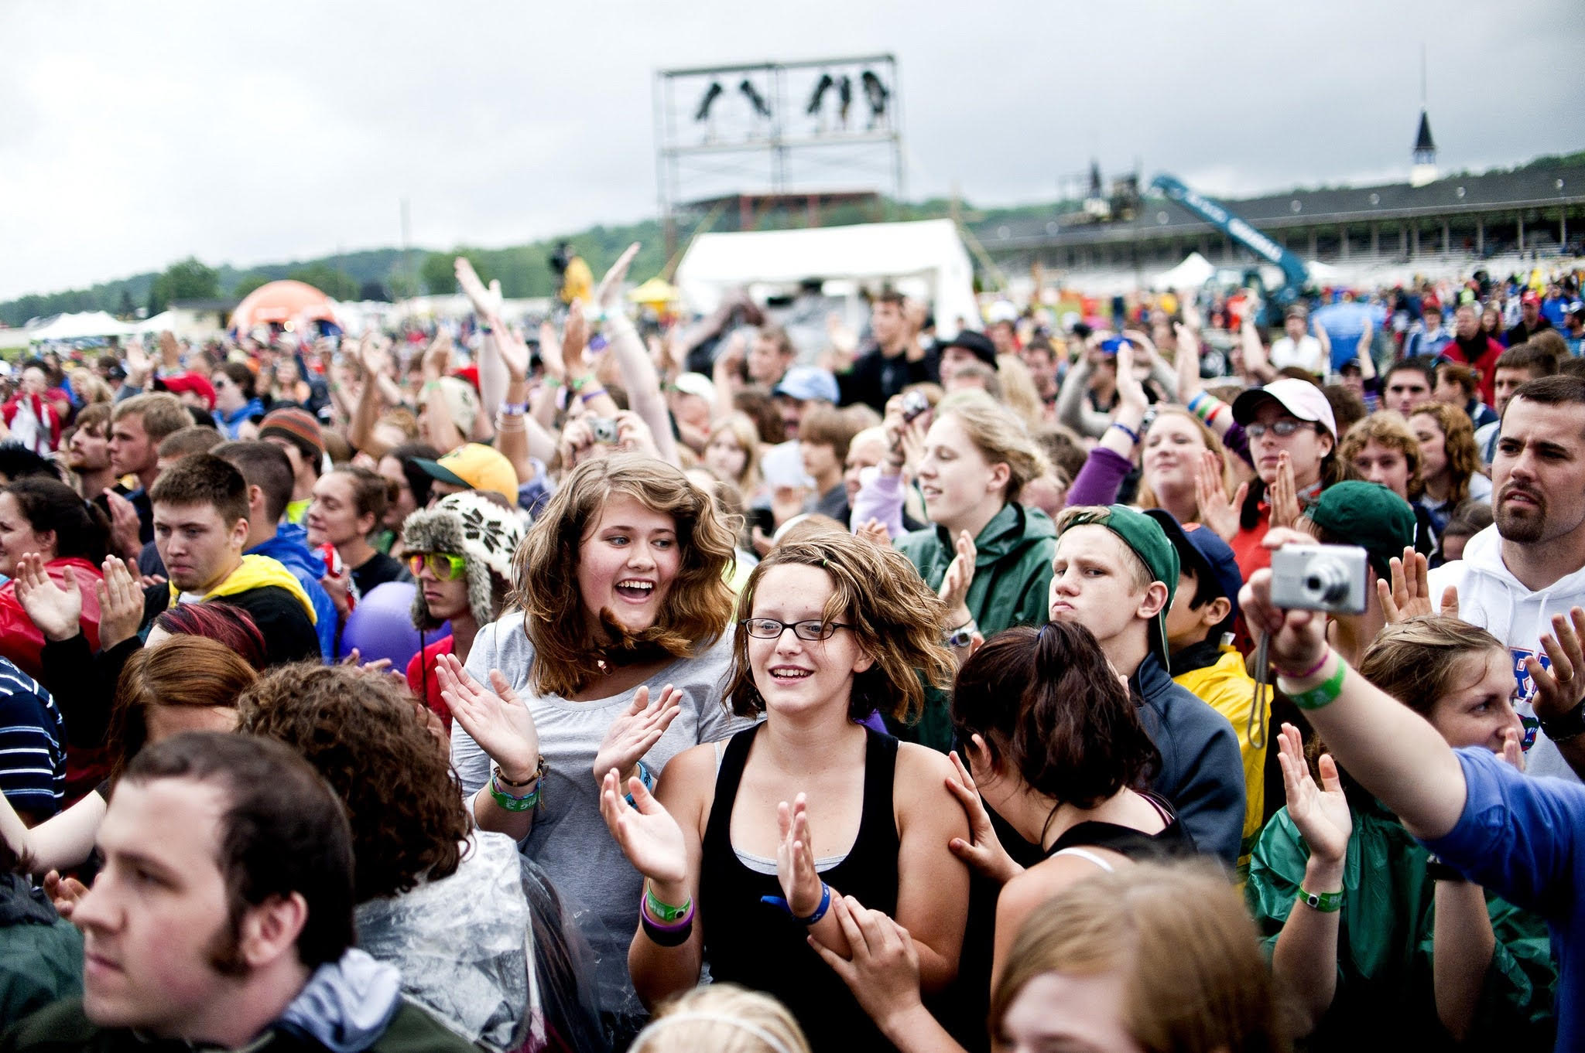
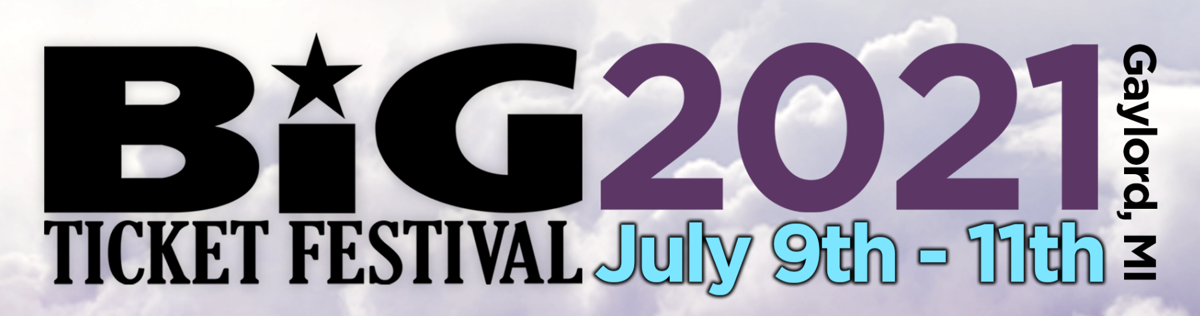
PriceSlide Case Studies
Ticket Sales for Big Ticket Festival in Gaylord, MI
Year one: 400% increase in early bird tickets sold (5% price reduction from previous year’s low ticket price)
Year two: 328% increase from early bird normal with 4% increase over normal “low ticket price”

Slide 10


Slide 11
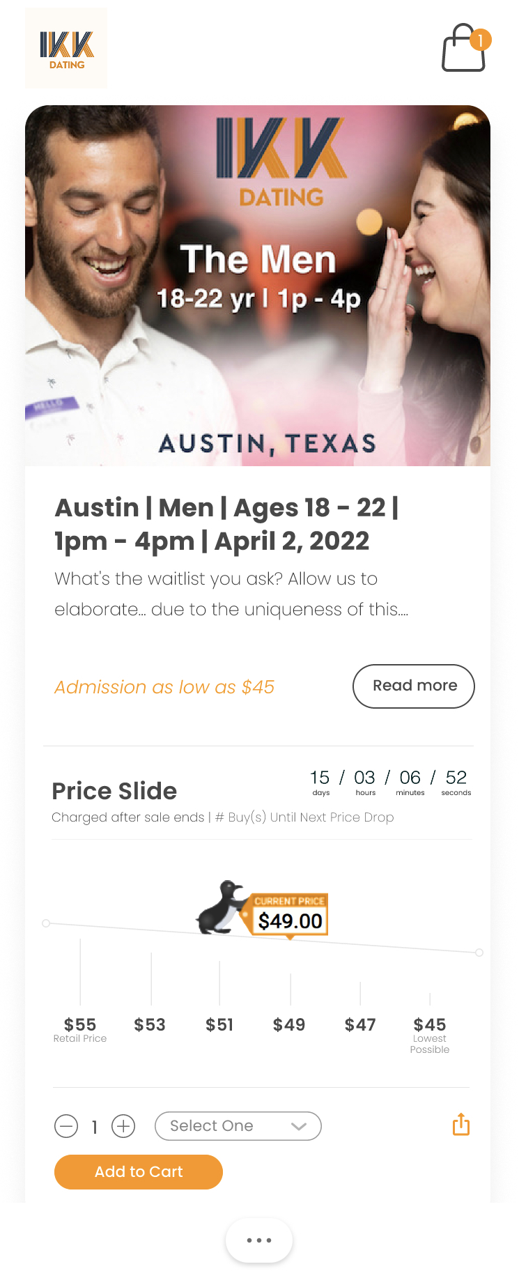
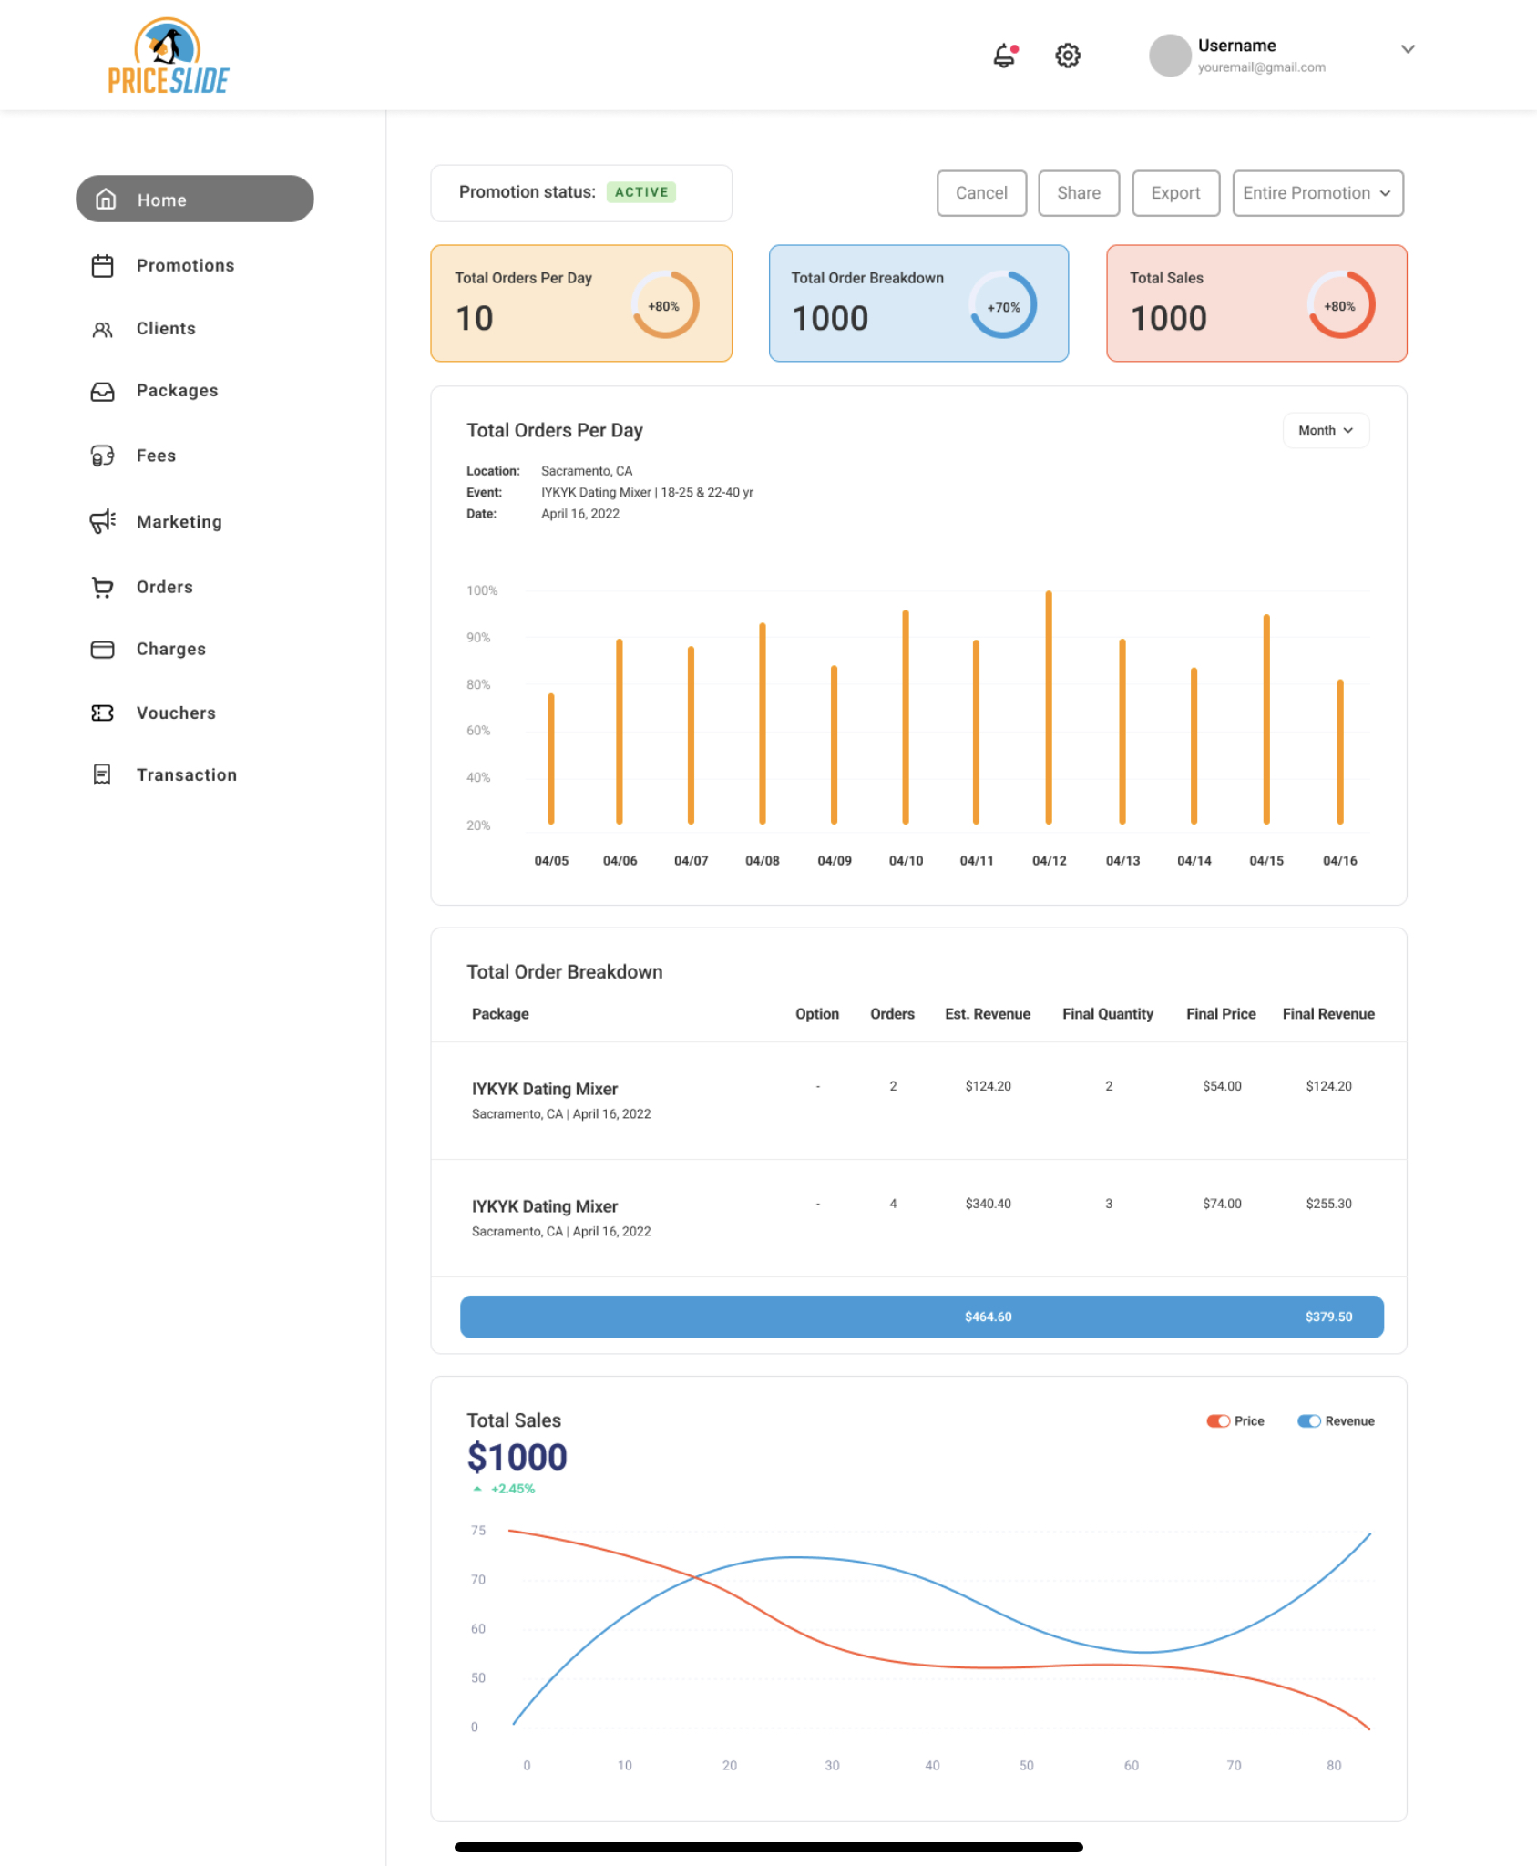
NEW Customer UI
New Client UI

